Slide 1
Obstacle Avoiding Robot (automated car)
PREPARED BY
ABINANDHU P

Slide 2
ABSTRACT
With the development of innovation in term of speed and particularity, the robotization of mechanical framework comes into the real world. In this paper an impediment recognition robot framework clarified for various purposes and applications. The ultrasonic and infrared sensors are realized to recognize obstructions on the robot's way by bestowing signs to and interfaced microcontroller.

Slide 3
We proposed a robot that avoids the obstacle which comes in its path this robot is introduced because in many of the industries we have seen that many heavy components which they have to move for one place to another place which is not possible without the help of machines. With this we got idea and we introduce the robot named as Obstacle avoidance robot using Arduino. Obstacle avoidance robot is design to allow robot to navigate in unknown environment by avoiding collisions.

Slide 4
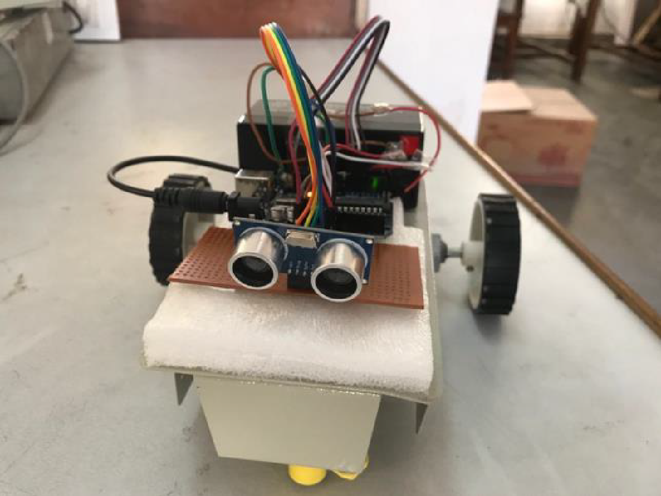
Obstacle Avoiding Robot Front view

Slide 5
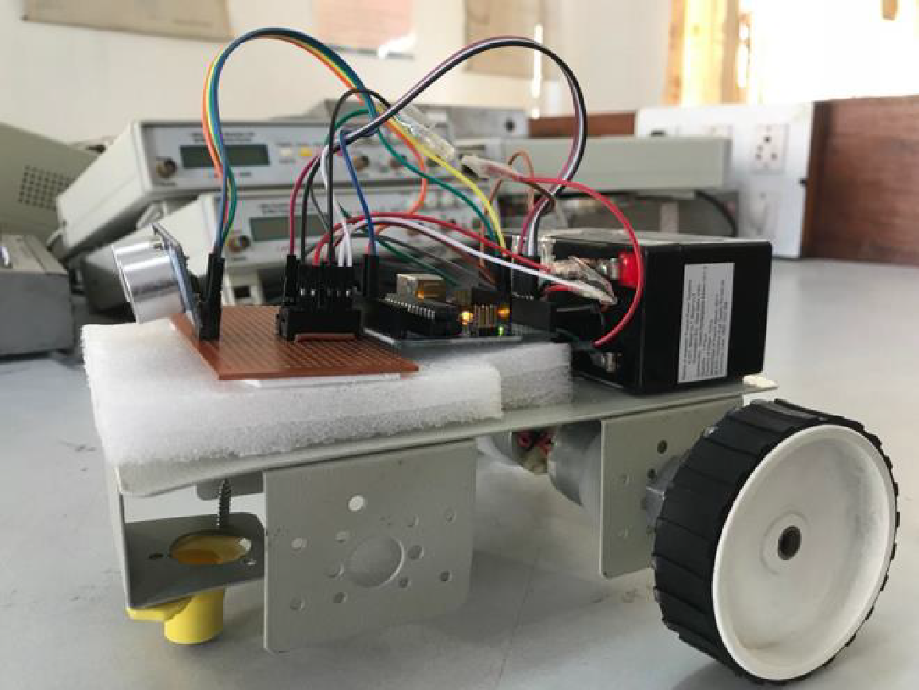
Obstacle Avoiding Robot side view

Slide 6
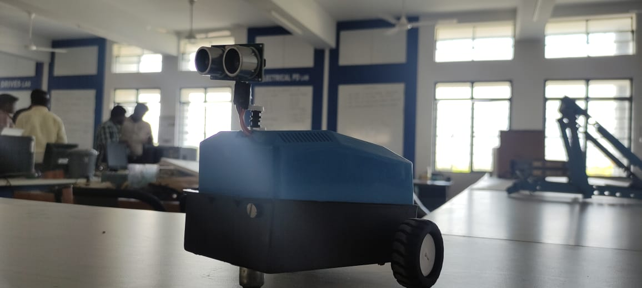
Model Of Our Obstacle Avoiding Robot

Slide 7
How do obstacle avoiding robots typically move and navigate?
If a wall is detected ahead, the robot turns left so that the wall is to its right. If a wall is detected to the right, the robot continues moving along the wall. If a corner is detected, the robot turns right to continue moving around the obstacle.

Slide 8
How does an autonomous robot detect obstacles?
The robot uses sensors to measure the distance between the robot and the obstacle. ... If the sensor detects an obstacle in the middle of the robot's path, then the algorithm randomly changes its direction to the left or right until the sensors no longer detect an obstacle.

Slide 9
th
MAIN THEME:
Obstacle avoider is mainly here preferred for the future non driver car. The main concept behind this is the car which operates with no driver namely aumatic controller car, which will act an great lead in industries .
This is the basic normal design for that proporse.

Slide 10
THANK YOU

